Slide 1
Line Follower
Project: Line Follower with PID algorytm

Slide 2
About Project
This is Line Follower project, so this is a line-tracking robot (this robot tracks a black line). The line tracking was implemented by using the PID algorithm (which is used for regulation). In addition, this vehicle has an infrared remote control mode.
"The brain" of the entire vehicle is the STM Nucleo-L053R8. The vehicle also has a second (additional) Freescale KL05Z32 board, which is responsible for displaying the current driving mode on the display and lighting up the appropriate diodes.
Both boards communicate via pins - the STM sends a signal when an event occurs, and the KL performs appropriate actions depending on the received signal.

Slide 3
Functionality
Following line
Controlling the vehicle with an infrared remote control
Use of the PID algorithm
Displaying driving mode
Lighting LEDs diodes depending on the moving direction and the selected driving mode

Slide 4
Parts
NUCLEO-L053R8 – logical part (microcontroller)
L298N – engine controller
2 x Mini engine MT78
Power supply 6 x 1,5V = 9V batteries AA
2 x photoresistors as a light sensors
wooden platform and two plastic wheels + one swivel wheel
small contact plate
Infrared receiver module 1838 - 38kHz - Iduino ST1089
Additional parts:
Freescale KL05Z32 (board)
LCD 2x16 Display + converter I2C LCM1602

Slide 5
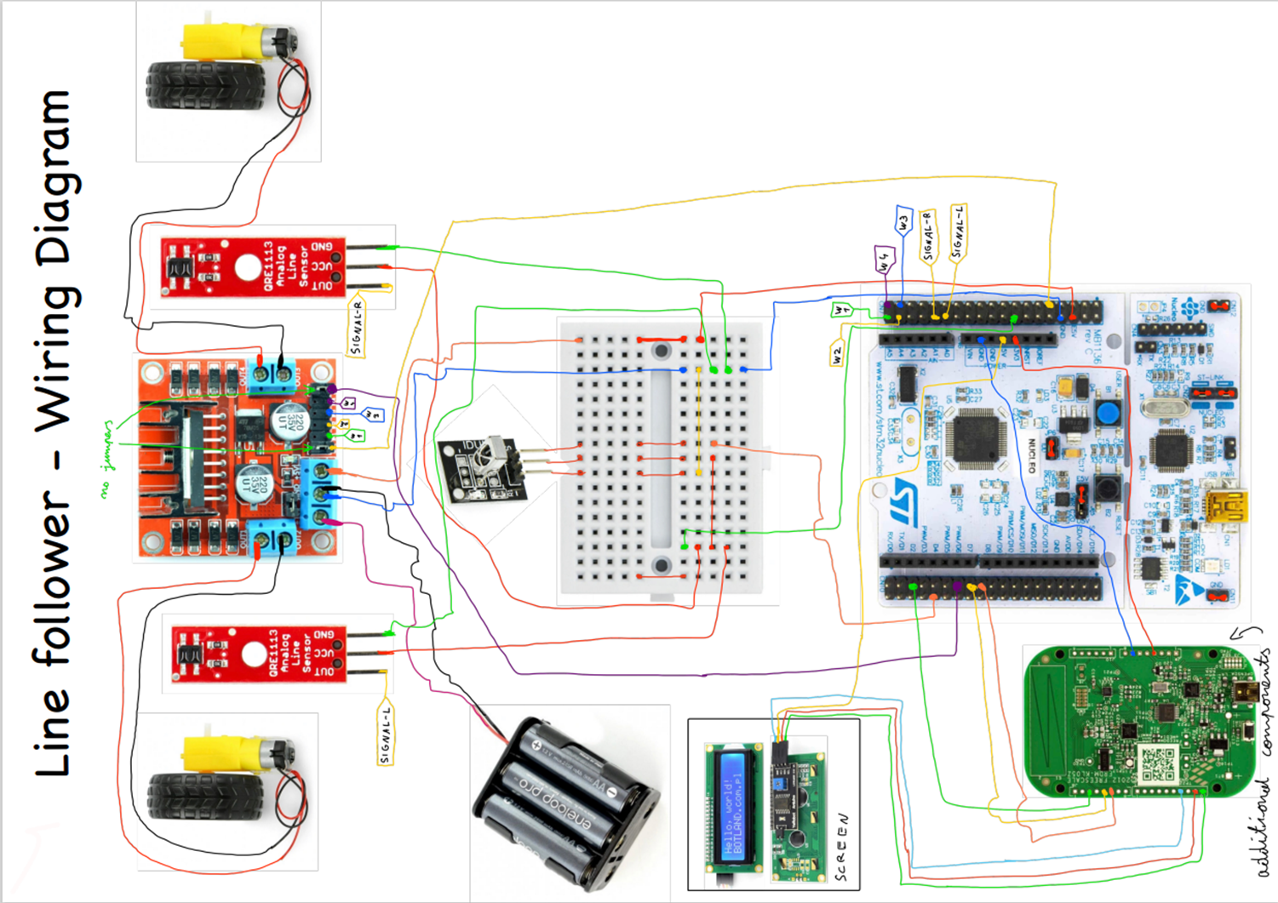
Wiring Diagram

Slide 6
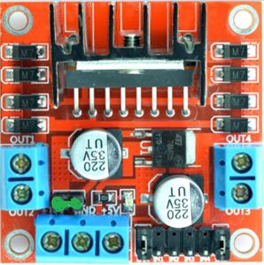
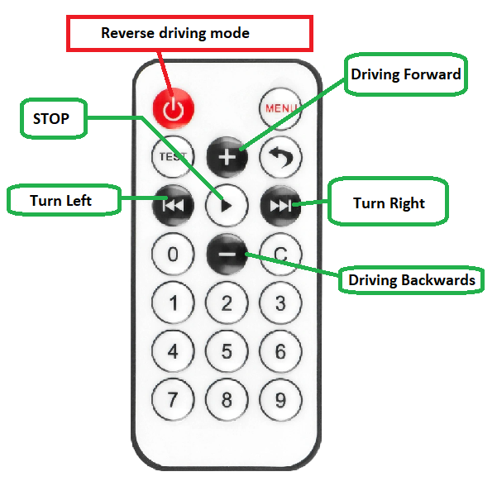
User Manual
To start the vehicle, insert a jumper into the motor controller (only the green one)
You can switch between driving modes in 2 ways: with the button on the remote control or the button on the STM:
black button on the board - remote control
blue button on the board - Line Follower

Slide 7
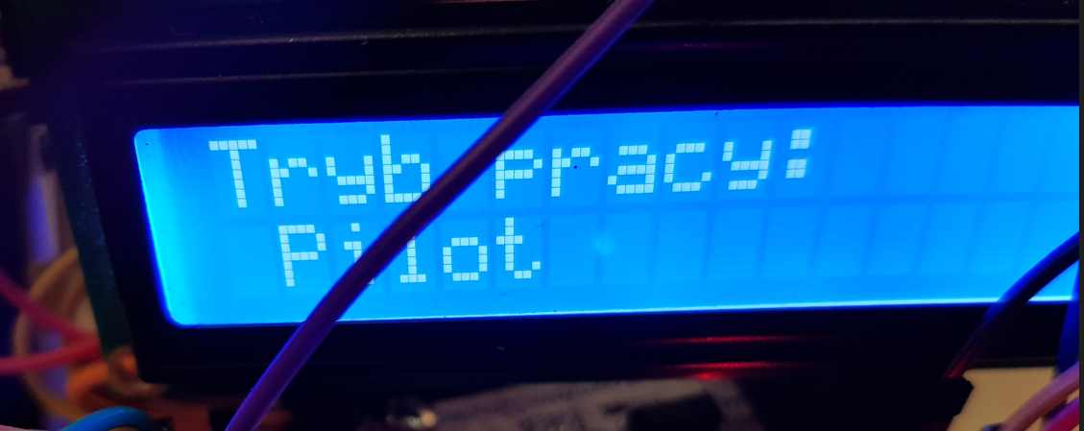
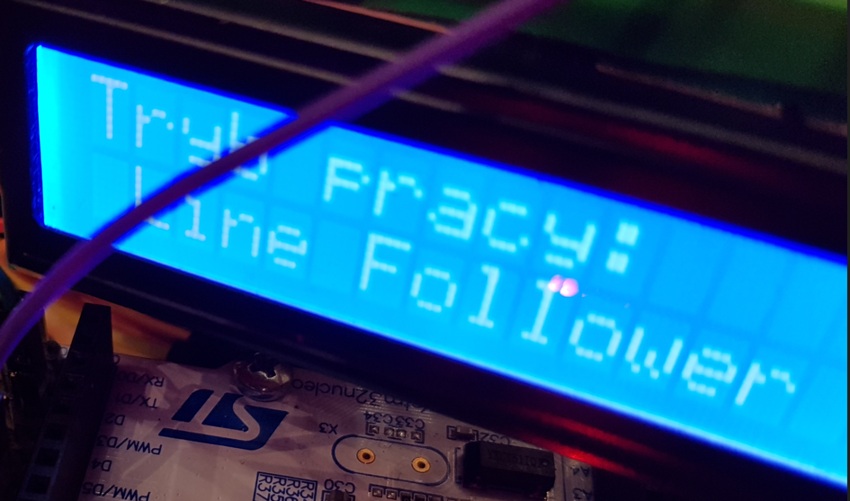
What do the LED colors mean
Red - driving right
Green - driving to the left
Yellow - drive forward
Blue - pilot driving mode
In pilot mode, the blue LED is always on, but the LEDs that indicate the moving direction are also ON, so going right is pink, left - light blue, straight - white
Line Follower also shows current driving mode on display

Slide 8
Link to Project GitHub
https://github.com/Daniel11000/Projekt-DL

